Slide 1
System Analysis and Project Management – Project Implementation & Post Implementation Activities
Prepared By - Vesh Raj Joshi

Slide 2
Implementation Phase
Concepts
As the design phase is completed, the systems analyst begins to focus on the tasks associated with building the system, ensuring that it performs as designed and developing documentation for the system. Programmers will carry out the time consuming and costly task of writing programs, while the systems analyst prepares plans for a variety of tests that will verify that the system performs as expected.
As the implementation phase begins, foremost on people’s minds is construction of the new system. Largest components of building the system is writing programs. Doing good, thorough job on the analysis and design phases is essential to a smooth and successful implementation phase.
The implementation phase consists of developing and testing the system’s software, documentation, and new operating procedures. Successful system implementation includes installation of the new system, selection of the most suitable conversion approach, preparing the organization and the users to adapt to the new system, and ensuring that the system is supported after it is put into production.

Slide 3
Project Implementation & Post Implementation Activities
Managing Programing Process
The programming process is quite well understood and generally flows smoothly.
Usually project fails, not because the programmers were unable to write the programs. Flaws in analysis, design, or project management are the leading contributors to project failure.
To ensure that the process of programming is conducted successfully,
project manager must do to manage the programming effort: assigning programming tasks, coordinating the activities, and managing the programming schedule.

Slide 4
Project Implementation & Post Implementation Activities – Managing Programming Process
Assigning programming tasks
project manager identified the programming support required for constructing the system in terms of the numbers and skill levels of programmers.
must assign program modules to the programming staff.
each programming module should be as separate and distinct as possible from the other modules
Module will be breakdown to single unit of task
Each task will be assigned to programmers
Experienced, skilled programmers will be assigned the most complex modules, while novice programmers will be given less complex ones
There will be a mismatch between the available programming skills and the programming skills that are needed to complete the programming

Slide 5
Project Implementation & Post Implementation Activities – Managing Programming Process
Assigning programming tasks
the project manager must take steps at this time to ensure that skill deficiencies are eliminated through additional training or through mentoring arrangements with more experienced, skilled programmers.
must assign program modules to the programming staff.
Note
required skills are not readily available, the project manager must incorporate additional time in the project schedule
Fat team – tempting to speedup the programming task - an ironic fact of system development is that the more programmers who are involved, the longer the project will take – communication, coordination increases exponentially

Slide 6
Project Implementation & Post Implementation Activities – Managing Programming Process
Assigning programming tasks
the project manager must take steps at this time to ensure that skill deficiencies are eliminated through additional training or through mentoring arrangements with more experienced, skilled programmers.
must assign program modules to the programming staff.
If it’s large project then break it down to small projects and develop them separately
Note
required skills are not readily available, the project manager must incorporate additional time in the project schedule
Fat team – tempting to speedup the programming task - an ironic fact of system development is that the more programmers who are involved, the longer the project will take – communication, coordination increases exponentially

Slide 7
Project Implementation & Post Implementation Activities – Managing Programming Process
Coordinating Activities
Coordination can be done through both high-­ tech and low-­ tech means.
The simplest approach is to have a weekly project meeting to discuss any changes to the system that have arisen during the past week ­ or just any issues that have come up.
Regular meetings, even if they are brief, encourage the widespread communication and discussion of issues before they become problems.
way to improve coordination is to create and follow standards that can range from formal rules for naming files to forms that must be completed when goals are reached to programming guidelines

Slide 8
Project Implementation & Post Implementation Activities – Managing Programming Process
Coordinating Activities
Many project teams set up three “areas” in which programmers can work: a development area, a testing area, and a production area.
Make working dashboard to show the task status along who is working on it. Work status board column be like to do, in progress, to be reviewed, in testing and in UAT and Done
Use version control system (GitHub, GitLab, Bitbucket) so that manual managing files is very big task
Use different servers for deployment – Development, QA, UAT, Staging and Production.

Slide 9
Project Implementation & Post Implementation Activities – Managing Programming Process
Managing Schedule
Time estimates that were produced during the initial planning phase and refined during the analysis and design phases must almost always be refined as the project progresses during construction, because it is virtually impossible to develop an exact assessment of the project’s schedule.
a well-­ done set of time estimates will usually have a 10% margin of error by the time implementation is reached
The issue of scope creep, becomes particularly troublesome at this stage. Scope creep occurs when new requirements are added to the project after the system design has been finalized.

Slide 10
Project Implementation & Post Implementation Activities – Managing Programming Process
Managing Schedule
unnoticed day-­ by-­ day slippages in the schedule. One module is a day late here; another one, a day late there. Pretty soon these minor delays add up, and the project is noticeably behind schedule.
the key to managing the programming effort is to watch these minor slippages carefully and update the schedule accordingly
a project manager will create a risk assessment that tracks potential risks, along with an evaluation of their likelihood and potential impact. As programming progresses, the list of risks will change as some items are removed and others surface. The best project managers, however, work hard to keep risks from having an impact on the schedule and costs associated with the project.

Slide 11
Project Implementation & Post Implementation Activities – Managing Programming Process
Testing
Writing programs is a fun, creative activity. Novice programmers tend to get caught up in the development of the programs themselves and are often much less enchanted with the tasks of testing and documenting their work.
Testing and documentation are not fun; consequently, they receive less attention than writing the programs
Programming and testing are similar to writing and editing
A program is not considered finished until it has passed its testing.
Testing is frequently the primary focus of the systems analysts as the system is being constructed. The analysts must resist the temptation to rush into testing as soon as the very first program module is complete, however. Spontaneously testing different events and possibilities without spending time to develop a comprehensive test plan is dangerous, because important tests may be overlooked.

Slide 12
Project Implementation & Post Implementation Activities – Managing Programming Process
Test Plan
Testing starts with the tester developing a test plan that defines a series of tests that will be conducted.
Each individual test has a specific objective, describes a set of specific test cases to examine, and defines the expected results and the actual results observed.
The test objective is taken directly from the program specification or from the program source code.

Slide 13
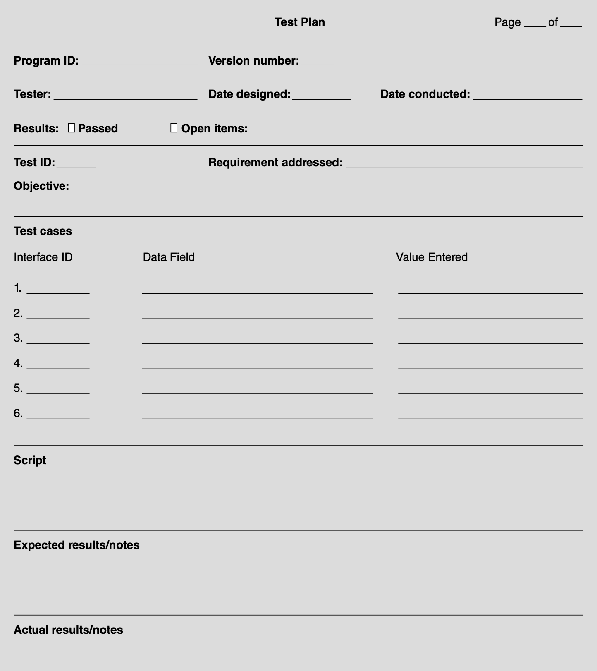
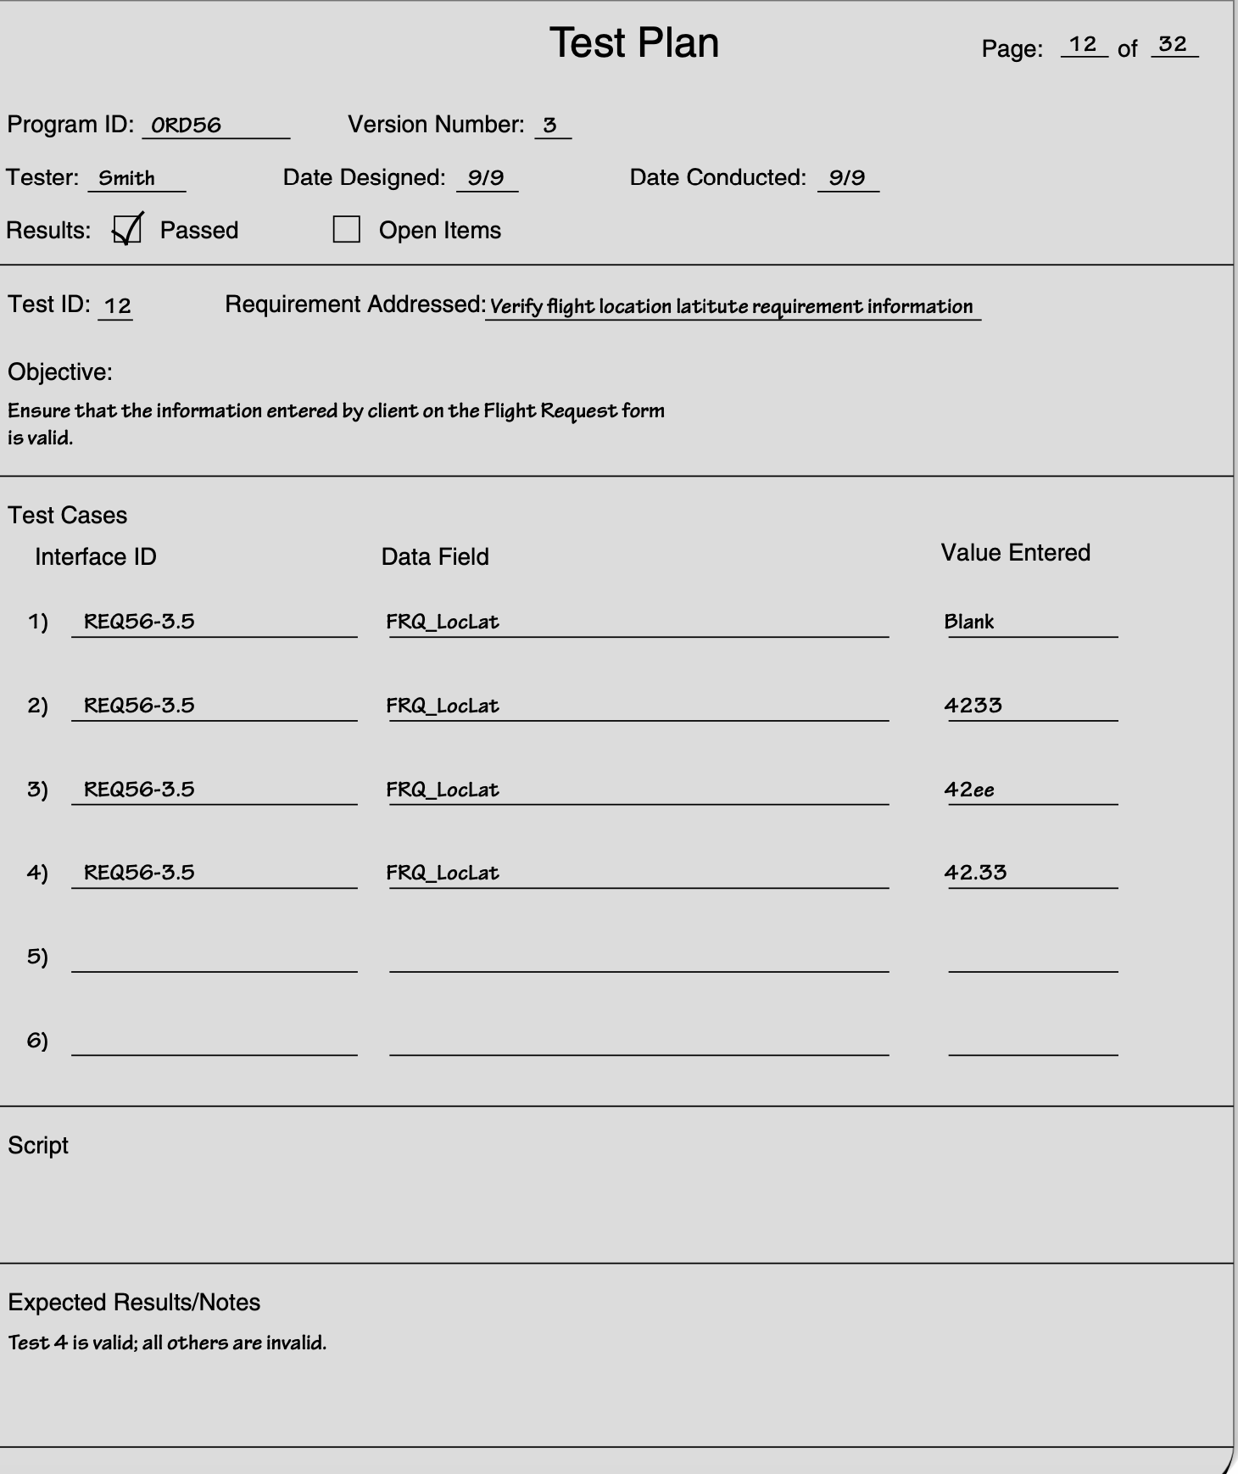
Project Implementation & Post Implementation Activities – Managing Programming Process
Test Plan Format

Slide 14
Project Implementation & Post Implementation Activities – Testing Strategies
Unit Test
Unit tests focus on one unit a program or a program module that performs a specific function that can be tested.
Purpose of a unit test is to ensure that the module or program performs its function as defined in the program specification.
Performed right after the program developed ;tested code to be error free and conducted by developer or system analyst.
tests are based strictly on the program specification and may discover errors resulting from the programmer’s misinterpretation of the specifications.

Slide 15
Project Implementation & Post Implementation Activities – Testing Strategies
Unit Test
Black Box Testing –
testing is the most used
Test plan is developed directly from the program specification: each item in the program specification becomes a test, and several test cases are developed for it.
White box testing
reserved for special circumstances
tester wants to review the actual program code, usually when complexity is high.

Slide 16
Project Implementation & Post Implementation Activities – Testing Strategies
Integration/Feature Test
Integration tests assess whether a set of modules or programs that must work together do so without error. They ensure that the interfaces and linkages between different parts of the system work properly.
Performed after unit test of each part or unit of code has been completed competed; so the focus now is on the flow of control among modules and on the data exchanged among them
the tester develops a test plan that has a series of tests. Integration testing is often done by a set of programmers and/ or systems analysts.
There are four approaches to integration testing: user interface testing, use scenario testing, data flow testing, and system interface testing. Most projects use all four approaches

Slide 17
Project Implementation & Post Implementation Activities – Testing Strategies
System Test
Integration tests assess whether a set of modules or programs that must work together do so without error. They ensure that the interfaces and linkages between different parts of the system work properly.
System tests are usually conducted by the systems analysts to ensure that all modules and programs work together without error.
System testing is similar to integration testing but is much broader in scope. Whereas integration testing focuses on whether the modules work together without error, system tests examine how well the system meets business requirements and its usability, security, and performance under heavy load. It also tests the system’s documentation.

Slide 18
Project Implementation & Post Implementation Activities – Testing Strategies
System Test
Integration tests assess whether a set of modules or programs that must work together do so without error. They ensure that the interfaces and linkages between different parts of the system work properly.
System tests are usually conducted by the systems analysts to ensure that all modules and programs work together without error.
System testing is similar to integration testing but is much broader in scope. Whereas integration testing focuses on whether the modules work together without error, system tests examine how well the system meets business requirements and its usability, security, and performance under heavy load. It also tests the system’s documentation.

Slide 19
Project Implementation & Post Implementation Activities – Testing Strategies
Acceptance Test
Acceptance tests are done primarily by the users with support from the project team.
The goal is to confirm that the system is complete, meets the business needs that prompted the system to be developed, and is acceptable to the users.
Acceptance testing is done in two stages: alpha testing, in which users test the system using made-­ up data, and beta testing, in which users begin to use the system with real data and carefully monitor the system for errors

Slide 20

Project Implementation & Post Implementation Activities
System Transition and Change management
Dirt road example – ruts on .
As people use a computer system or set of work processes, those system/work processes begin to become habits or norms; people learn them and become comfortable with them.
System or work processes then begin to limit people’s activities and make it difficult for them to change because they begin to see their jobs in terms of these processes rather than in terms of the final business goal of serving customers.

Slide 21
Project Implementation & Post Implementation Activities
System Transition and Change management
One of the earliest models for managing organizational change was developed by Kurt Lewin. Lewin argued that change is a three-­ step process: unfreeze, move, refreeze.
Unfreeze - project team must unfreeze the existing habits and norms (the as-­ is system) so that change is possible. Convey information that new system is being developed; involve them in design and analysis phase to understand the problems with existing system.
Move or transition – migration plan is needed. Conversion strategy needs to be selected, determining the style of the switch from the old to new system. Plans should be there to handle potential business disruption due to technical problems during conversion should be outlined as business contingency plan.
Refreeze - the new system as the habitual way of performing the work processes—­ ensuring that the new system successfully becomes the standard way of performing the business functions it supports.

Slide 22
Project Implementation & Post Implementation Activities – Migration Plan
Migration plan
The transition from the old business processes and computer programs to the new business processes and computer programs will be facilitated by ensuring that a number of business, technical, and people issues are addressed.
The migration plan specifies what activities will be performed when and by whom as the transition is made from the old to the new system.
To ensure that business is ready to make the transition, the project team must determine the best conversion strategy to use as the new system is introduced to the organization.
Also, plans should be made to ensure that the business can continue its operations even in the event of technical glitches in the new system.

Slide 23
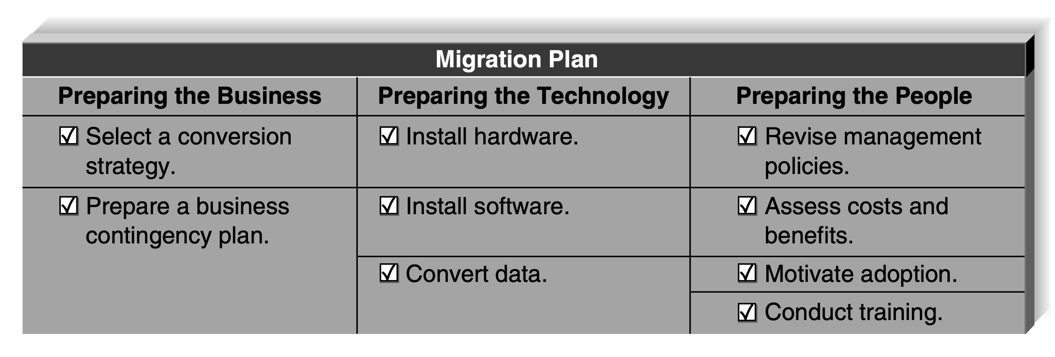
Project Implementation & Post Implementation Activities – Migration Plan
Migration plan

Slide 24
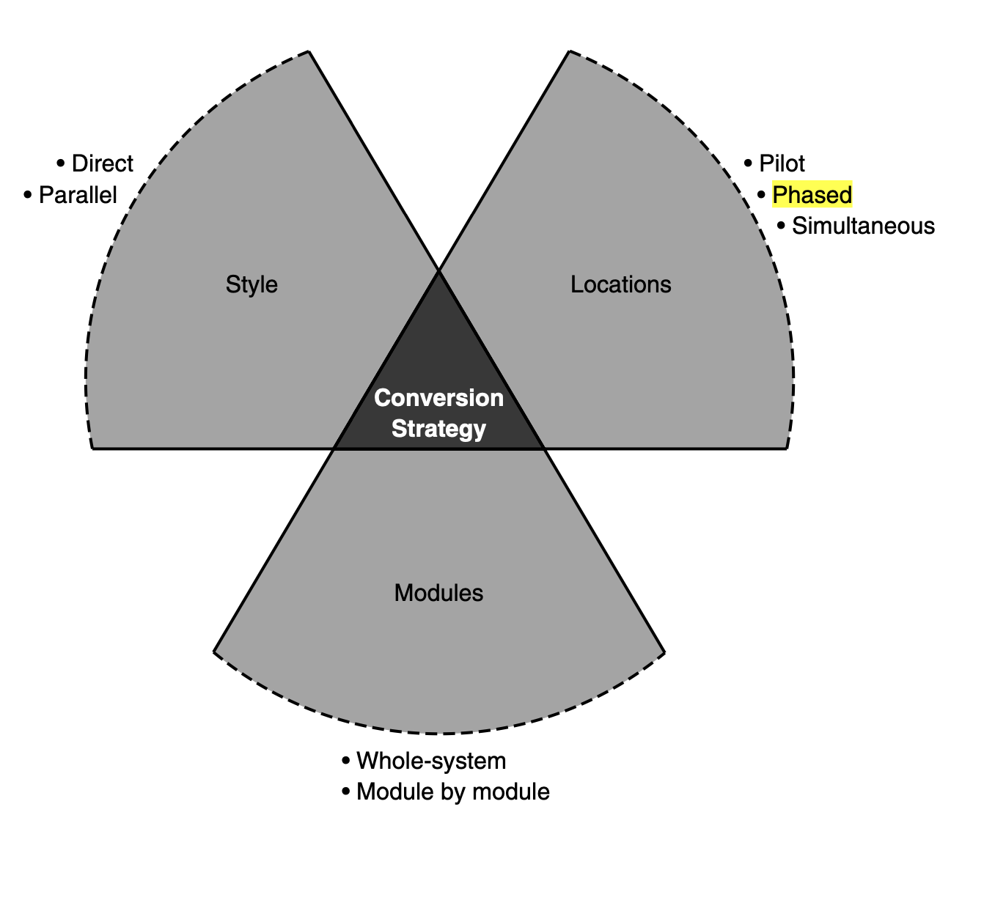
Project Implementation & Post Implementation Activities – Migration Plan
Migration strategies /Conversion Strategy
The process by which the new system is introduced into the organization is called the conversion strategy.
Implementing strategy must consider following
Conversion Style
Conversion Location
Conversion Module

Slide 25
Project Implementation & Post Implementation Activities – Migration Plan / Conversion Style
Conversion Style
Direct : Abrupt switch or change is called direct conversion
Involve instant replacement of the old system with the new one
Complete shutdown to old system
Often coinciding with a fiscal year change or other calendar event
Straight forward and risky; any issues with new system may seriously disrupt the organization’s ability and all other functions.
Parallel: Gradual introduction is made with parallel conversion
Both old an new systems are used simultaneously for the period of time
Reduce risks by providing organization with a fallback position if major problems are encountered with the new system
It add expense, however, as users are required to do their job tasks twice: once with each system that performs the same functions.

Slide 26
Project Implementation & Post Implementation Activities – Migration Plan / Conversion Style
Conversion Location
The new system can be introduced to different parts of the organization at different times, or it can be introduced throughout the organization at the same time.
Pilot Conversion: selects one or more locations to be converted first as a part of a pilot test.
If the conversion at the pilot location is successful, then the system is installed at the remaining location.
Pilot conversion has the advantage of limiting the effect of the new system to just the pilot location.
Additional level of testing is provided before the new system in introduced organization wide.
This type of conversion can be done only in organizations that can tolerate different locations using different systems and business processes for a certain length of time.
It also obviously requires a considerable time before the system is installed at all organizational

Slide 27
Project Implementation & Post Implementation Activities – Migration Plan / Conversion Style
Conversion Location
Phased Conversion: selects one or more set of locations to be converted in multiple phases.
With phased conversion, a first set of locations is converted, then a second set, then a third set, and so on, until all locations are converted.
Sometimes there is a deliberate delay between the phases, so that any problems with the system are detected before too much of the organization is affected.
In other circumstances, the project team may begin a new phase immediately following the completion of the previous phase.

Slide 28
Project Implementation & Post Implementation Activities – Migration Plan / Conversion Style
Conversion Location
Simultaneous Conversion: all locations at once.
May be necessary to convert all locations at the same time, suggesting the need for simultaneous conversion.
The new system is installed at all locations at once, thus eliminating the problem of having different organizational units using different systems and processes.
The drawback of this option is that there must be sufficient staff to perform the conversion and train the users at all locations simultaneously.

Slide 29
Project Implementation & Post Implementation Activities – Migration Plan / Conversion Style
Conversion Location
Simultaneous Conversion: all locations at once.
May be necessary to convert all locations at the same time, suggesting the need for simultaneous conversion.
The new system is installed at all locations at once, thus eliminating the problem of having different organizational units using different systems and processes.
The drawback of this option is that there must be sufficient staff to perform the conversion and train the users at all locations simultaneously.

Slide 30
Project Implementation & Post Implementation Activities
Change management
The process of helping people adjust to the new system and its new work processes without undue stress is called change management
Sponsor: of the change—­ the person who wants the change. This person is the business sponsor who first initiated the request for the new system
Change Agent— the person(s) leading the change effort. The change agent, charged with actually planning and implementing the change, is usually someone outside of the business unit adopting the system and therefore has no direct management authority over the potential adopters This person(s) is outsider with different thought process and work culture and is less credible than sponsor
Potential Adopter: target of the change—­ the people who actually must change.

Slide 31
Project Implementation & Post Implementation Activities
People Resistance
People resist change—­ even change for the better—­ for very rational reasons
What is good for the organization is not necessarily good for the people who work there.
Learning to use the new system and work processes—­ even if the change is minor—­ requires more effort than continuing to use the existing, well-­ understood system and work processes
So why do people accept change?
Simply put, every change has a set of costs and benefits associated with it. If the benefits of accepting the change outweigh the costs of the change, then people change.
And sometimes the benefit of change is avoidance of the pain that you would experience if you did not adopt the change (e.g., if you don’t change, you are fired, so one of the benefits of adopting the change is that you still have a job).

Slide 32
Project Implementation & Post Implementation Activities – Managing user Resistance
Change Management Plan
Revising management policies Management policies provide goals, define how work processes should be performed, and determine how organizational members are rewarded.
standard operating procedures (SOPs) that become the habitual routines for how work is performed. The SOPs are both formal and informal.
Measurements and rewards: What does it mean to “be successful” or “do good work”? and “what gets measured gets done”
Resource allocation: Managers can have a clear and immediate impact on behavior by allocating resources. They can redirect funds and staff from one project to another, create an infrastructure that supports the new system, and invest in training programs. Each of these activities has both a direct and a symbolic effect. The direct effect comes from the actual reallocation of resources. The symbolic effect shows that management is serious about its intentions.

Slide 33
Project Implementation & Post Implementation Activities – Managing user Resistance
Change Management Plan
Assessing the cost and benefit models of potential adopters
list of costs and benefits is developed from the viewpoints of the different potential adopters expected to change, or stakeholders in the change.
Each of these potential adopters or stakeholders may have a different set of costs and benefits associated with the change—­ costs and benefits that can differ widely from those of the organization. In some situations, unions may be key stakeholders that can make or break successful change.
An analysis of the costs and benefits for each set of potential adopters or stakeholders will help pinpoint those who will likely support the change and those who may resist the change. The challenge at this point is to try to change the balance of the costs and benefits for those expected to resist the change so that they support it (or at least do not actively resist it)
uncover some serious problems that have the potential to block the succesful adoption of the system.

Slide 34
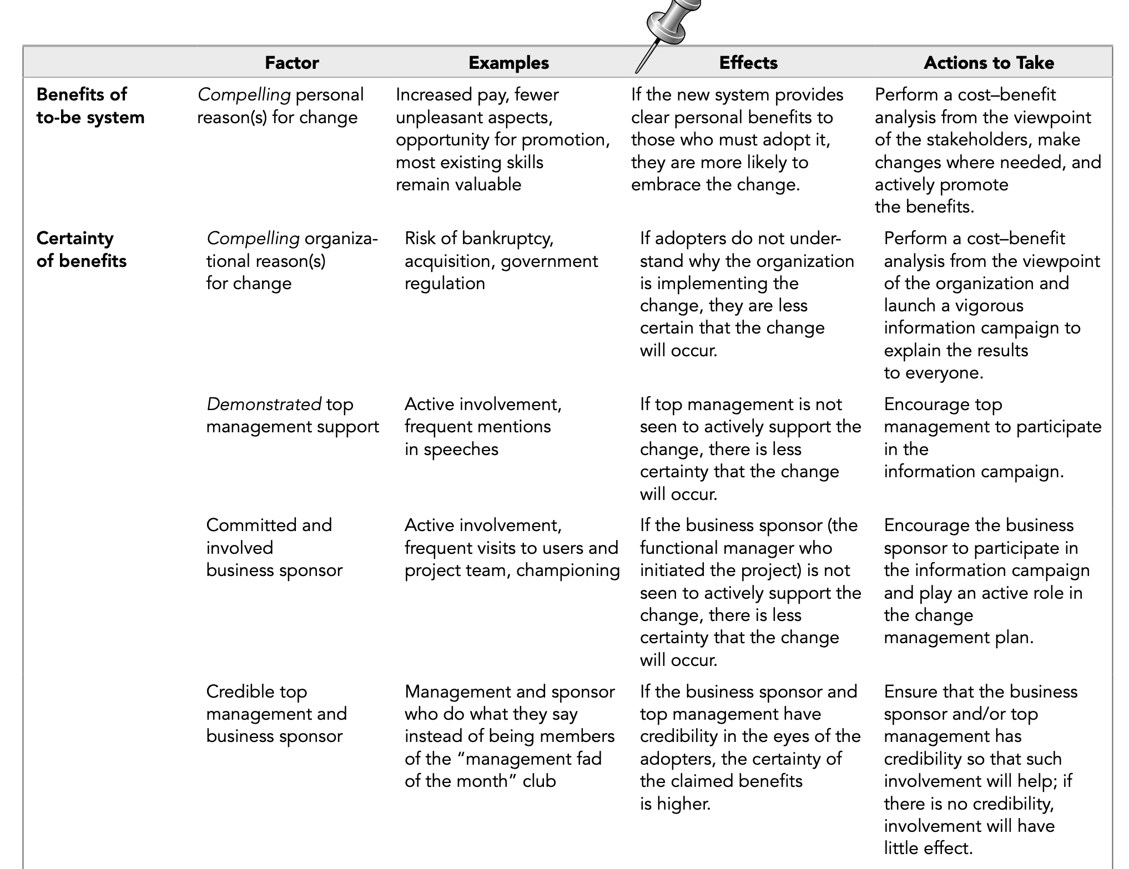
Project Implementation & Post Implementation Activities –
Cost and benefits

Slide 35
Project Implementation & Post Implementation Activities – Managing user Resistance
Change Management Plan
Motivating adoption Single most important factor in motivating a change is providing clear and convincing evidence of the need for change. Simply put, everyone who is expected to adopt the change must be convinced that the benefits from the to-­ be system outweigh the costs of changing.
Motivating strategies
Informational : informational strategy, the goal is to convince potential adopters that the change is for the better. This strategy works when the cost–benefit set of the target adopters has more benefits than costs.
Political- With a political strategy, organi-zational power, not information, is used to motivate change. This approach is often used when the cost–benefit set of the target adopters has more costs than benefits.

Slide 36
Project Implementation & Post Implementation Activities – Managing user Resistance
Change Management Plan
Enabling people to adopt through training
Potential adopters may want to adopt the change, but unless they are capable of adopting it, they won’t. Adoption is enabled by providing employees the skills needed to adopt the change through careful training.
Training is probably the most self-­ evident part of any change management initiative. How can an organization expect its staff members to adopt a new system if they are not trained?

Slide 37
Project Implementation & Post Implementation Activities
Postimplementation activities
The goal of postimplementation activities is to institutionalize the use of the new system—­ that is, to make it the normal, accepted, routine way of performing the business processes.
The post-implementation activities attempt to refreeze the organization after the successful transition to the new system.
Conducting reviews and system support
Once the project team has installed the system and performed the change management activities, the system is officially turned over to the operations group.
Members of the operations group usually are integrally involved in the installation activities because they are the ones who must ensure that the system actually works.
Operating group give feedback and reviews.

Slide 38
Project Implementation & Post Implementation Activities
Conducting reviews and system support
Providing system support means helping the users to use the system. Usually, this means providing answers to questions and helping users understand how to perform a certain function; this type of support can be thought of as on-demand training.
Online support is the most common form of on-­demand training. This includes the documentation and help screens built into the system, as well as separate websites that provide answers to frequently asked questions (FAQs) that enable users to find answers without contacting a person. Obviously, the goal of most systems is to provide sufficiently good online support so that the user does not need to contact a person, because providing online support is much less expensive than is providing a person to answer questions.
Most organizations provide a help desk that provides a place for a user to talk with a person who can answer questions (usually over the phone, but sometimes in person). The help desk supports all systems, not just one specific system, so it receives calls about a wide variety of software and hardware.

Slide 39
Project Implementation & Post Implementation Activities
Conducting reviews and system support
Change requests typically come from five sources.
Bug -The most common source is problem reports from the operations group that identify bugs in the system that must be fixed. These are usually given immediate priority because a bug can cause significant problems.
Feature Enhancement- Feature needs to improved
Other system development – to integrate with other system
Underlying software or networks change – OS, Security Concerns
Changes in the organization’s strategy – Company strategy changes

Slide 40
Hmmmm..
That’s end of Unit V
Thank you

